Slide 1
ECE 143 Team 6
UCSD Summer Session Analytics
Albert Tan
Alex Ng
Derek Lee
Yancong Deng
Notes:
All of us

Slide 2
Project Overview
Objective
Data Scraping and Limitations of the Dataset
Summer and Non-Summer Course Comparisons
Analysis of Summer Course Data
Notes:
Derek
There are four main sections of our presentation

Slide 3
Objective
How do summer courses differ from their non-summer courses?
GPA and study hours
class-sizes
recommendation rates
Predict summer GPA based on non-summer GPA counterpart
Is there any correlation between the data given by CAPE, such as professor recommendations, grades received, and hours spent studying?
Notes:
Derek
How do summer courses differ from the non-summer counterparts.
Can we accurately predict the average grade of a summer course from the average grade of it’s non-summer counterpart?
Is there any correlation between the data given by CAPE, such as professor recommendations, grades received, and hours spent studying?

Slide 4
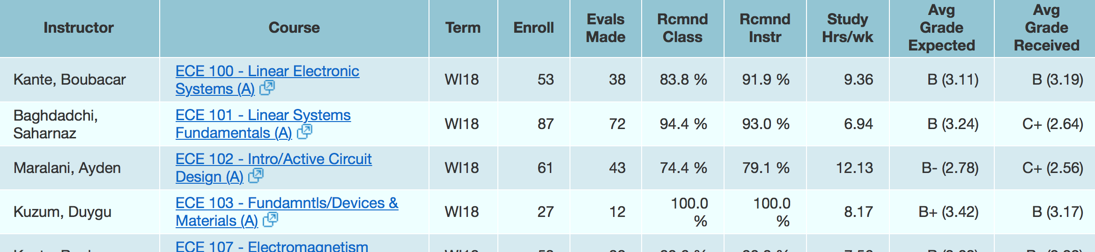
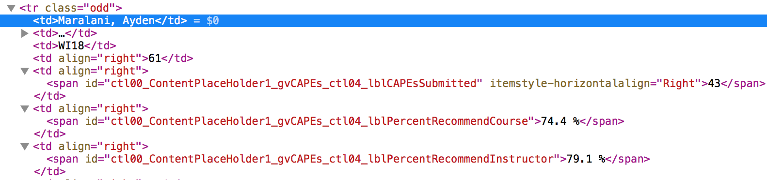
Data Source - cape.ucsd.edu
Notes:
Derek

Slide 5
Data Clustering
Collect UCSD Aggregate data
Cluster into 3 Disciplines (Engineering, Humanities, Social Sciences)
Divide each discipline into 5 biggest departments within each discipline
UCSD Aggregate
Engineering
CSE
ECE
MAE
SE
NANO
2. Humanities
PHIL
HIEA
MUS
TD
VIS
3. Social Sciences
ECON
POLI
COGS
PSYC
MGS
Notes:
Derek
Intuitive clustering, we do analysis on each of the three disciplines later on

Slide 6
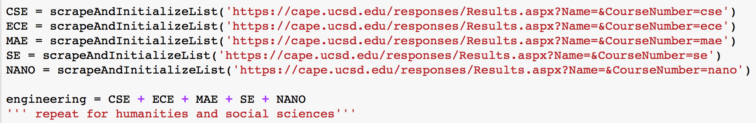
Data Scraping
Store URL’s for each of the 15 departments
For each URL: append all rows from html table using BeautifulSoup
Filter out:
courses before 2011
courses that don’t have a summer session counterpart
courses that have N/A CAPE reports
Concatenate into 3 Disciplines (Engineering, Humanities, Social Sciences)
Notes:
Derek

Slide 7
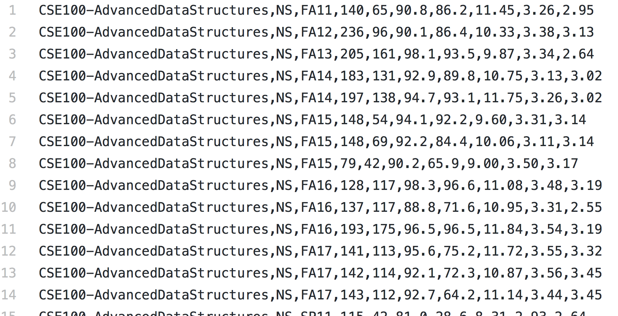
Writing to txt/csv file
converted from python Lists
row formatting like CAPE
comma separated columns
input into Pandas
screenshot: small portion of engineering.txt
Notes:
derek

Slide 8
Limitations of the Dataset
Incomplete data (N/A for received grades, expected grades, etc.)
Only data for summer classes after 2011
Low evaluation response rate for some summer courses
Notes:
albert

Slide 9
Summer and Non-Summer Course Comparisons
Notes:
alb

Slide 10
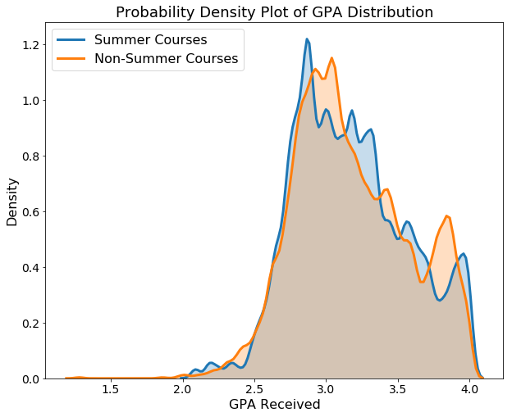
Density Distribution of GPA Received: UCSD Aggregate
Notes:
alb

Slide 11
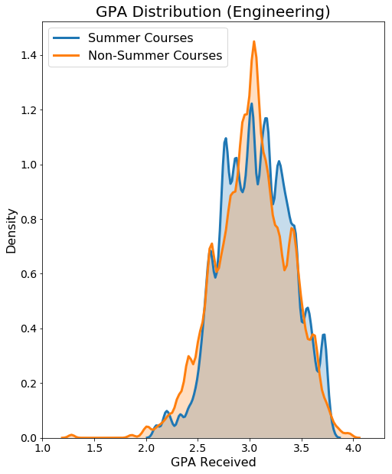
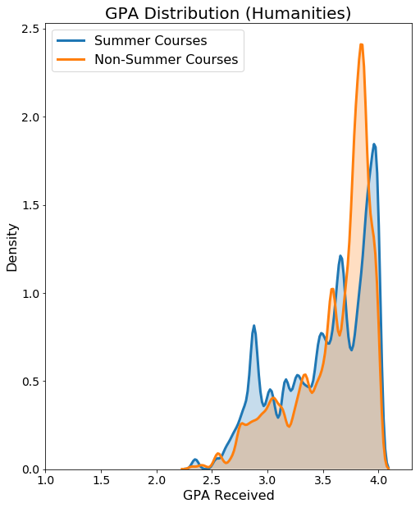
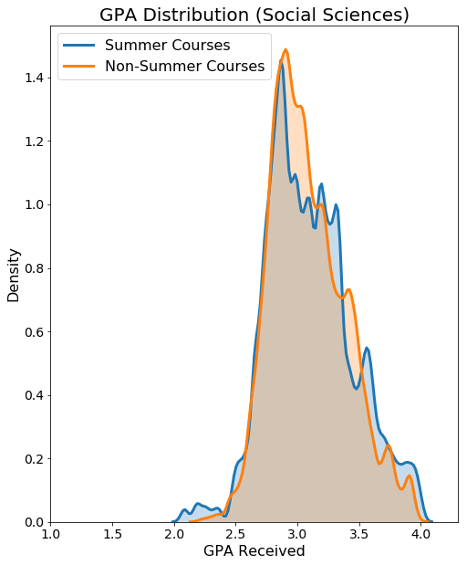
Density Distributions Across Each Major Discipline
Notes:
alb

Slide 12
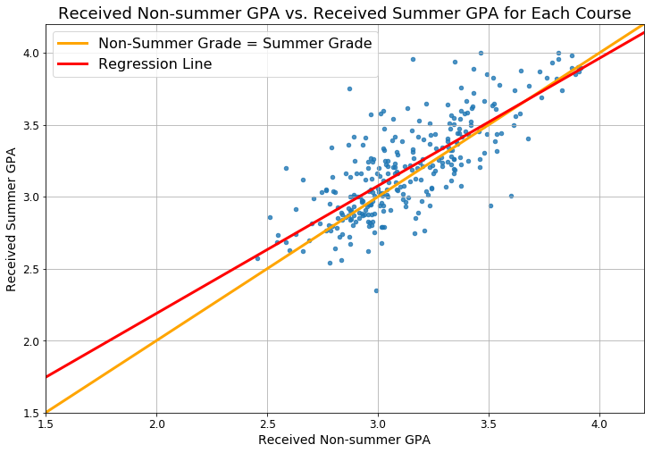
Relationship between UCSD Summer GPA and Non-Summer GPA
r² value: 0.5948
p value: 4.845e-58
S_GPA = 0.89*NS_GPA + 0.42
NS GPA | S GPA
2.0 (C) | 2.2
2.3 (C+) | 2.5
2.7 (B-) | 2.8
3.0 (B) | 3.1
3.3 (B+) | 3.3
3.7 (A-) | 3.7
4.0 (A) | 4.0
Notes:
Albert
r^2 is regression.
R is correlation
The data is decently well-fitted to the regression line.

Slide 13
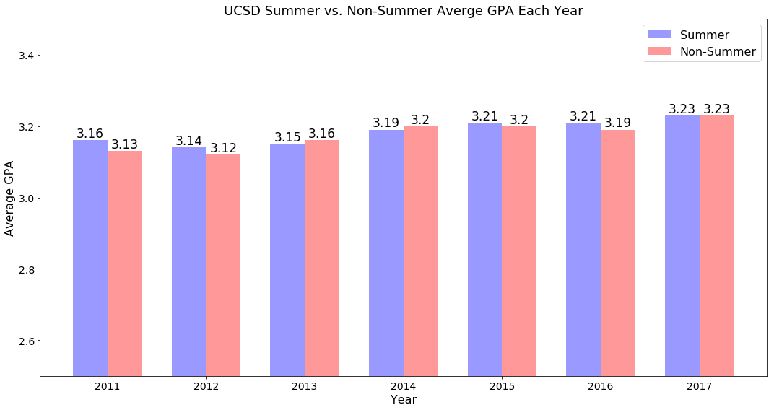
Average UCSD Grades Received By Year
Notes:
yan

Slide 14
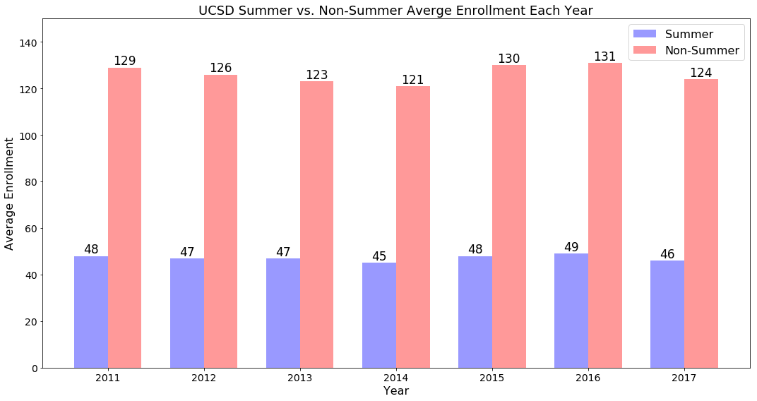
Average UCSD Course Enrollment
Notes:
yan

Slide 15
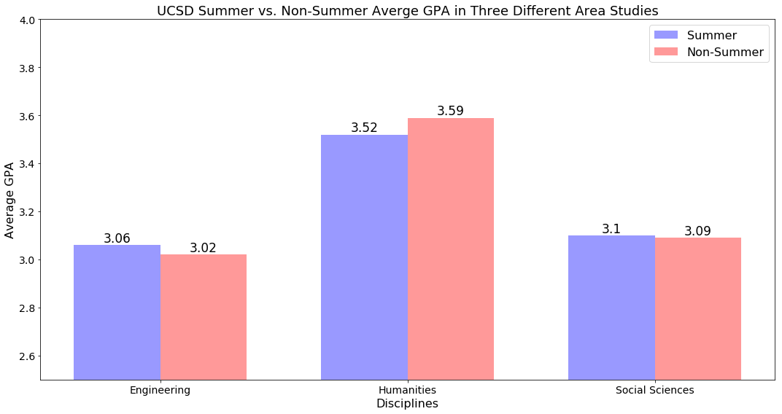
Overall GPA in Different Disciplines
(Summer vs. Non-Summer)
Notes:
yan

Slide 16
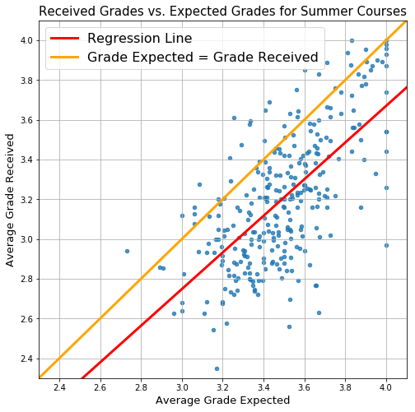
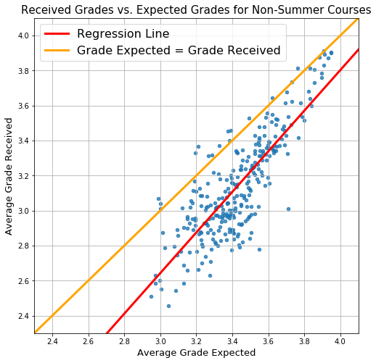
Relationship between UCSD Expected and Received Grades
Slope: 0.9218, Intercept: -0.0175
r value: 0.6614, p value: 1.3498e-37
Slope: 1.1598, Intercept: -0.8364
r value: 0.8211, p value: 1.2741e-71
Notes:
alex

Slide 17
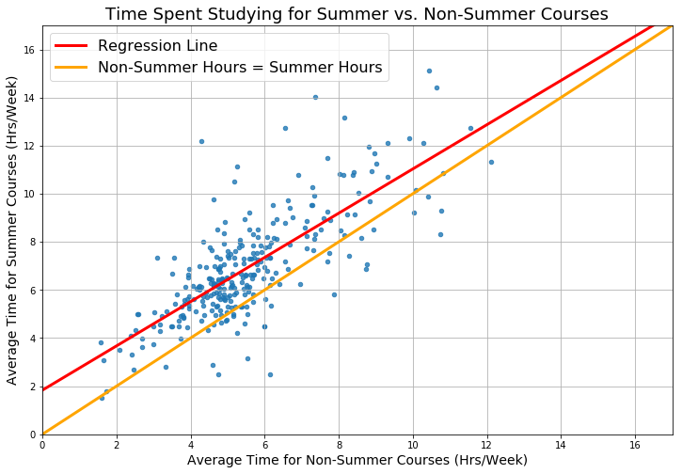
Time Commitment of UCSD Courses
Slope: 0.9198, Intercept: 1.8321
r value: 0.7621, p value: 6.2827e-56
Notes:
alex

Slide 18
Summer Analysis of CAPE Survey Responses
Notes:
alex

Slide 19
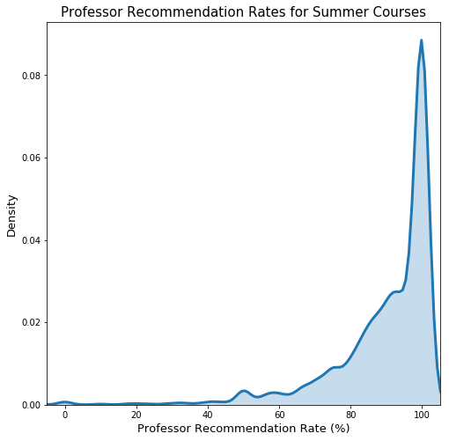
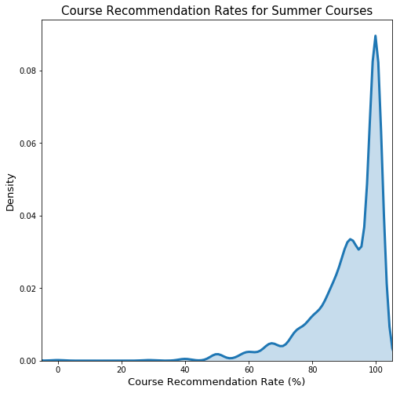
Density Distributions of Professor and Course Recommendations
Notes:
alex

Slide 20
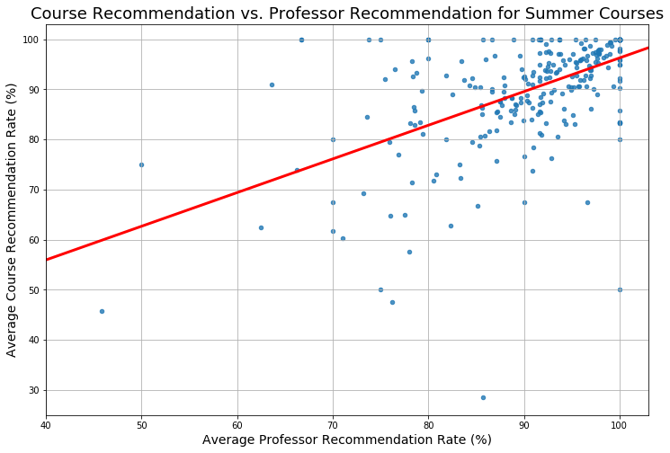
Relationship between Professor and Course Recommendation
Slope: 0.6718, Intercept: 29.0903
r value: 0.5520, p value: 2.2655e-24
Notes:
alex

Slide 21
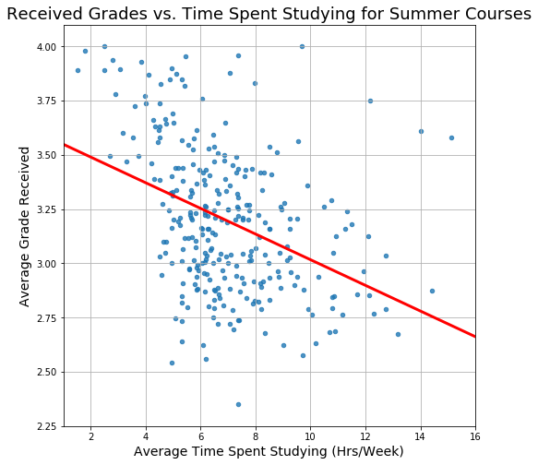
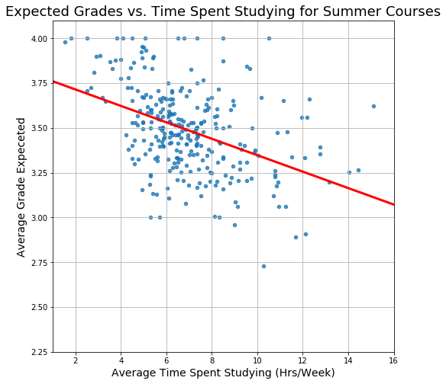
Relationship between Study Hours and Grades
Slope: -0.0591, Intercept: 3.6084
r value: -0.3927, p value: 4.7015e-12
Slope: -0.0459, Intercept: 3.8066
r value: -0.4246, p value: 4.8996e-14
Notes:
alex

Slide 22
Conclusion
There is very little difference in difficulty between summer and non-summer courses: GPA’s are roughly equal
However, summer class-sizes are smaller
Students spend slightly more time on summer-courses, but many students take only 1 summer course/summer session: more summer free time, overall
There’s minimal advantage or risk in summer session. Thus, plan your schedule out like you normally would, it’s basically the same thing!
Notes:
albert

